Slide 1
MYME WEB MAKERS
BY MYME TECHNOLOGY WEB CREATERS

Slide 2
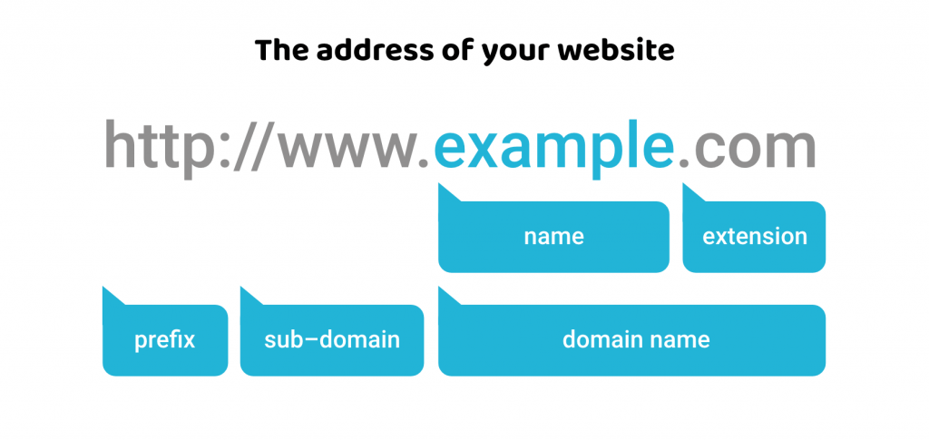
DOMAIN AND DOMAIN NAME SPACE
What Is a Domain?
A domain is a part of the web address nomenclature someone would use to find your website or a page of your website online. It is a string of text associated with the numerical IP address of a website that's much easier for people to remember and search.

Slide 3
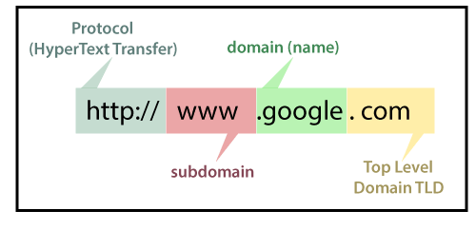
THREE TYPES OF DOMAIN NAME
Subdomain or third-level domain, such as www.
Second-Level Domain (SLD), which is the name of the website.
Top-Level Domain (TLD), such as com.

Slide 4

WEB HOSTING
When a hosting provider allocates space on a web server for a website to store its files, they are hosting a website.
The three main types of web hosting are:
Shared Hosting: Shared hosting is the most basic and affordable option. ...
Virtual Private Server (VPS) Hosting: VPS hosting provides a more robust solution than shared hosting. ...
Dedicated Hosting: Dedicated hosting is the most powerful and expensive option.

